Slide 1
Unit 6
OODB and Distributed Database
Copyright © 2007 Ramez Elmasri and Shamkant B. Navathe

Slide 2
Object-Oriented Database ( OODB )
1 Overview of Object-Oriented Concepts
2 Overview of the Object Model ODMG
3 The Object Definition Language DDL
4 The Object Query Language OQL
5 Object Database Conceptual Model
Slide 21- <number>

Slide 3
U6 Introduction
Traditional Data Models:
  Hierarchical
  Network (since mid-60’s)
  Relational (since 1970 and commercially since 1982)
Object Oriented (OO) Data Models since mid-90’s
Reasons for creation of Object Oriented Databases
  Need for more complex applications
  Need for additional data modeling features
  Increased use of object-oriented programming languages
Commercial OO Database products –
  Several in the 1990’s, but did not make much impact on mainstream data management
Slide 20- <number>

Slide 4
History of OO Models and Systems
Languages:
  Simula (1960’s)
  Smalltalk (1970’s)
  C++ (late 1980’s)
  Java (1990’s and 2000’s)
Slide 20- <number>

Slide 5
History of OO Models and Systems (contd.)
Experimental Systems:
  Orion at MCC
  IRIS at H-P labs
  Open-OODB at T.I.
  ODE at ATT Bell labs
  Postgres - Montage - Illustra at UC/B
  Encore/Observer at Brown
Slide 20- <number>

Slide 6
History of OO Models and Systems (contd.)
Commercial OO Database products:
  Ontos
  Gemstone
  O2 ( -> Ardent)
  Objectivity
  Objectstore ( -> Excelon)
  Versant
  Poet
  Jasmine (Fujitsu – GM)
Slide 20- <number>

Slide 7
U6.1 Overview of Object-Oriented Concepts(1)
Main Claim:
  OO databases try to maintain a direct correspondence between real-world and database objects so that objects do not lose their integrity and identity and can easily be identified and operated upon
Object:
  Two components:
    state (value) and behavior (operations)
  Similar to program variable in programming language, except that it will typically have a complex data structure as well as specific operations defined by the programmer
Slide 20- <number>

Slide 8
Overview of Object-Oriented Concepts (2)
In OO databases, objects may have an object structure of arbitrary complexity in order to contain all of the necessary information that describes the object.
In contrast, in traditional database systems, information about a complex object is often scattered over many relations or records, leading to loss of direct correspondence between a real-world object and its database representation.
Slide 20- <number>

Slide 9
Overview of Object-Oriented Concepts (3)
The internal structure of an object in OOPLs includes the specification of instance variables, which hold the values that define the internal state of the object.
An instance variable is similar to the concept of an attribute, except that instance variables may be encapsulated within the object and thus are not necessarily visible to external users
Slide 20- <number>

Slide 10
Overview of Object-Oriented Concepts (4)
Some OO models insist that all operations a user can apply to an object must be predefined. This forces a complete encapsulation of objects.
To encourage encapsulation, an operation is defined in two parts:
  signature or interface of the operation, specifies the operation name and arguments (or parameters).
  method or body, specifies the implementation of the operation.
Slide 20- <number>

Slide 11
Overview of Object-Oriented Concepts (5)
Operations can be invoked by passing a message to an object, which includes the operation name and the parameters.
  The object then executes the method for that operation.
This encapsulation permits modification of the internal structure of an object, as well as the implementation of its operations, without the need to disturb the external programs that invoke these operations
Slide 20- <number>

Slide 12
Overview of Object-Oriented Concepts (6)
Some OO systems provide capabilities for dealing with multiple versions of the same object (a feature that is essential in design and engineering applications).
  For example, an old version of an object that represents a tested and verified design should be retained until the new version is tested and verified:
  very crucial for designs in manufacturing process control, architecture , software systems …..
Slide 20- <number>

Slide 13
Overview of Object-Oriented Concepts (7)
Operator polymorphism:
  This refers to an operation’s ability to be applied to different types of objects; in such a situation, an operation name may refer to several distinct implementations, depending on the type of objects it is applied to.
This feature is also called operator overloading
Slide 20- <number>

Slide 14
Objectives
Discuss the importance of standards (e.g., portability, interoperability)
Introduce Object Data Management Group (ODMG): object model, object definition language (ODL), object query language (OQL)
Present ODMG object binding to programming languages (e.g., C++)
Present Object Database Conceptual Design
Slide 21- <number>

Slide 15
U6.2 The Object Model of ODMG
Provides a standard model for object databases
Supports object definition via ODL
Supports object querying via OQL
Supports a variety of data types and type constructors
Slide 21- <number>

Slide 16
ODMG Objects and Literals
The basic building blocks of the object model are
  Objects
  Literals
An object has four characteristics
  Identifier: unique system-wide identifier
  Name: unique within a particular database and/or program; it is optional
  Lifetime: persistent vs. transient
  Structure: specifies how object is constructed by the type constructor and whether it is an atomic object
Slide 21- <number>

Slide 17
ODMG Literals
A literal has a current value but not an identifier
Three types of literals
  atomic: predefined; basic data type values (e.g., short, float, boolean, char)
  structured: values that are constructed by type constructors (e.g., date, struct variables)
  collection: a collection (e.g., array) of values or objects
Slide 21- <number>

Slide 18
ODMG Interface Definition:
An Example
Note: interface is ODMG’s keyword for class/type
  interface Date:Object {
  enum weekday{sun,mon,tue,wed,thu,fri,sat};
  enum Month{jan,feb,mar,…,dec};
  unsigned short year();
  unsigned short month();
  unsigned short day();
  …
  boolean is_equal(in Date other_date);
  };
Slide 21- <number>

Slide 19
Built-in Interfaces for
Collection Objects
A collection object inherits the basic collection interface, for example:
  cardinality()
  is_empty()
  insert_element()
  remove_element()
  contains_element()
  create_iterator()
Slide 21- <number>

Slide 20
Collection Types
Collection objects are further specialized into types like a set, list, bag, array, and dictionary
Each collection type may provide additional interfaces, for example, a set provides:
  create_union()
  create_difference()
  is_subset_of(
  is_superset_of()
  is_proper_subset_of()
Slide 21- <number>

Slide 21
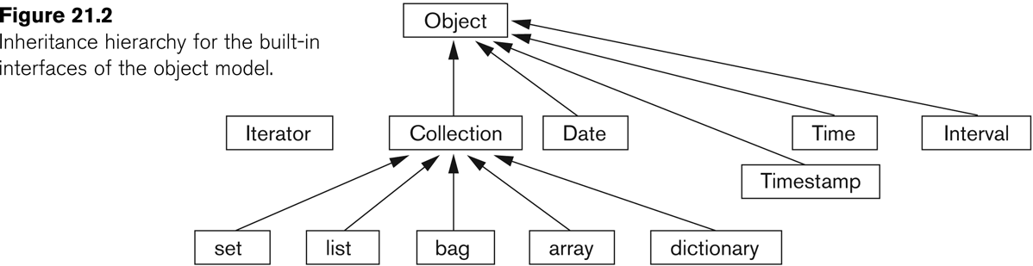
Object Inheritance Hierarchy
Slide 21- <number>

Slide 22
Atomic Objects
Atomic objects are user-defined objects and are defined via keyword class
An example:
  class Employee (extent all_emplyees key ssn) {
  attribute string name;
  attribute string ssn;
  attribute short age;
  relationship Dept works_for;
  void reassign(in string new_name);
  }
Slide 21- <number>

Slide 23
Class Extents
An ODMG object can have an extent defined via a class declaration
  Each extent is given a name and will contain all persistent objects of that class
  For Employee class, for example, the extent is called all_employees
  This is similar to creating an object of type Set<Employee> and making it persistent
Slide 21- <number>

Slide 24
Class Key
A class key consists of one or more unique attributes
For the Employee class, the key is ssn
  Thus each employee is expected to have a unique ssn
Keys can be composite, e.g.,
  (key dnumber, dname)
Slide 21- <number>

Slide 25
Object Factory
An object factory is used to generate individual objects via its operations
An example:
  interface ObjectFactory {
  Object new ();
  };
new() returns new objects with an object_id
One can create their own factory interface by inheriting the above interface
Slide 21- <number>

Slide 26
Interface and Class Definition
ODMG supports two concepts for specifying object types:
  Interface
  Class
There are similarities and differences between interfaces and classes
Both have behaviors (operations) and state (attributes and relationships)
Slide 21- <number>

Slide 27
ODMG Interface
An interface is a specification of the abstract behavior of an object type
  State properties of an interface (i.e., its attributes and relationships) cannot be inherited from
  Objects cannot be instantiated from an interface
Slide 21- <number>

Slide 28
ODMG Class
A class is a specification of abstract behavior and state of an object type
  A class is Instantiable
  Supports “extends” inheritance to allow both state and behavior inheritance among classes
  Multiple inheritance via “extends” is not allowed
Slide 21- <number>

Slide 29
U6.3 Object Definition Language
ODL supports semantics constructs of ODMG
ODL is independent of any programming language
ODL is used to create object specification (classes and interfaces)
ODL is not used for database manipulation
Slide 21- <number>

Slide 30
ODL Examples (1)
A Very Simple Class
A very simple, straightforward class definition
  (all examples are based on the university schema presented in Chapter 4):
  class Degree {
  attribute string college;
  attribute string degree;
  attribute string year;
  };
Slide 21- <number>

Slide 31
ODL Examples (2)
A Class With Key and Extent
A class definition with “extent”, “key”, and more elaborate attributes; still relatively straightforward
  class Person (extent persons key ssn) {
  attribute struct Pname {string fname …} name;
  attribute string ssn;
  attribute date birthdate;
  …
  short age();
  }
Slide 21- <number>

Slide 32
ODL Examples (3)
A Class With Relationships
Note extends (inheritance) relationship
Also note “inverse” relationship
  class Faculty extends Person (extent faculty) {
  attribute string rank;
  attribute float salary;
  attribute string phone;
  …
  relationship Dept works_in inverse Dept::has_faculty;
  relationship set<GradStu> advises inverse GradStu::advisor;
  void give_raise (in float raise);
  void promote (in string new_rank);
  };
Slide 21- <number>

Slide 33
Inheritance via “:” – An Example
interface Shape {
attribute struct point {…} reference_point;
float perimeter ();
…
};
class Triangle: Shape (extent triangles) {
attribute short side_1;
attribute short side_2;
…
};
Slide 21- <number>

Slide 34
U6.4 Object Query Language
OQL is DMG’s query language
OQL works closely with programming languages such as C++
Embedded OQL statements return objects that are compatible with the type system of the host language
OQL’s syntax is similar to SQL with additional features for objects
Slide 21- <number>

Slide 35
Simple OQL Queries
Basic syntax: select…from…where…
  SELECT d.name
  FROM d in departments
  WHERE d.college = ‘Engineering’;
An entry point to the database is needed for each query
An extent name (e.g., departments in the above example) may serve as an entry point
Slide 21- <number>

Slide 36
Iterator Variables
Iterator variables are defined whenever a collection is referenced in an OQL query
Iterator d in the previous example serves as an iterator and ranges over each object in the collection
Syntactical options for specifying an iterator:
  d in departments
  departments d
  departments as d
Slide 21- <number>

Slide 37
Data Type of Query Results
The data type of a query result can be any type defined in the ODMG model
A query does not have to follow the select…from…where… format
A persistent name on its own can serve as a query whose result is a reference to the persistent object. For example,
  departments; whose type is set<Departments>
Slide 21- <number>

Slide 38
Path Expressions
A path expression is used to specify a path to attributes and objects in an entry point
A path expression starts at a persistent object name (or its iterator variable)
The name will be followed by zero or more dot connected relationship or attribute names
  E.g., departments.chair;
Slide 21- <number>

Slide 39
Views as Named Objects
The define keyword in OQL is used to specify an identifier for a named query
The name should be unique; if not, the results will replace an existing named query
Once a query definition is created, it will persist until deleted or redefined
A view definition can include parameters
Slide 21- <number>

Slide 40
An Example of OQL View
A view to include students in a department who have a minor:
  define has_minor(dept_name) as
  select s
  from s in students
  where s.minor_in.dname=dept_name
has_minor can now be used in queries
Slide 21- <number>

Slide 41
Single Elements from Collections
An OQL query returns a collection
OQL’s element operator can be used to return a single element from a singleton collection that contains one element:
  element (select d from d in departments
  where d.dname = ‘Software Engineering’);
If d is empty or has more than one elements, an exception is raised
Slide 21- <number>

Slide 42
Collection Operators
OQL supports a number of aggregate operators that can be applied to query results
The aggregate operators and operate over a collection and include
  min, max, count, sum, avg
count returns an integer; others return the same type as the collection type
Slide 21- <number>

Slide 43
An Example of an OQL
Aggregate Operator
To compute the average GPA of all seniors majoring in Business:
  avg (select s.gpa from s in students
  where s.class = ‘senior’ and
  s.majors_in.dname =‘Business’);
Slide 21- <number>

Slide 44
Membership and Quantification
OQL provides membership and quantification operators:
  (e in c) is true if e is in the collection c
  (for all e in c: b) is true if all e elements of collection c satisfy b
  (exists e in c: b) is true if at least one e in collection c satisfies b
Slide 21- <number>

Slide 45
An Example of Membership
To retrieve the names of all students who completed CS101:
  select s.name.fname s.name.lname
  from s in students
  where 'CS101' in
  (select c.name
  from c
  in s.completed_sections.section.of_course);
Slide 21- <number>

Slide 46
Ordered Collections
Collections that are lists or arrays allow retrieving their first, last, and ith elements
OQL provides additional operators for extracting a sub-collection and concatenating two lists
OQL also provides operators for ordering the results
Slide 21- <number>

Slide 47
An Example of Ordered Operation
To retrieve the last name of the faculty member who earns the highest salary:
  first (select struct
  (faculty: f.name.lastname,
  salary f.salary)
  from f in faculty
  ordered by f.salary desc);
Slide 21- <number>

Slide 48
Grouping Operator
OQL also supports a grouping operator called group by
To retrieve average GPA of majors in each department having >100 majors:
  select deptname, avg_gpa:
  avg (select p.s.gpa from p in partition)
  from s in students
  group by deptname: s.majors_in.dname
  having count (partition) > 100
Slide 21- <number>

Slide 49
U6.5 Object Database
Conceptual Design
Object Database (ODB) vs. Relational Database (RDB)
  Relationships are handled differently
  Inheritance is handled differently
  Operations in OBD are expressed early on since they are a part of the class specification
Slide 21- <number>

Slide 50
Relationships: ODB vs. RDB (1)
Relationships in ODB:
  relationships are handled by reference attributes that include OIDs of related objects
  single and collection of references are allowed
  references for binary relationships can be expressed in single direction or both directions via inverse operator
Slide 21- <number>

Slide 51
Relationships: ODB vs.. RDB (2)
Relationships in RDB:
  Relationships among tuples are specified by attributes with matching values (via foreign keys)
  Foreign keys are single-valued
  M:N relationships must be presented via a separate relation (table)
Slide 21- <number>

Slide 52
Inheritance Relationship in ODB vs. RDB
Inheritance structures are built in ODB (and achieved via “:” and extends operators)
RDB has no built-in support for inheritance relationships; there are several options for mapping inheritance relationships in an RDB (see Chapter 7)
Slide 21- <number>

Slide 53
Early Specification of Operations
Another major difference between ODB and RDB is the specification of operations
  ODB:
    Operations specified during design (as part of class specification)
  RDB:
    Operations specification may be delayed until implementation
Slide 21- <number>

Slide 54
Mapping EER Schemas to ODB Schemas
Mapping EER schemas into ODB schemas is relatively simple especially since ODB schemas provide support for inheritance relationships
Once mapping has been completed, operations must be added to ODB schemas since EER schemas do not include an specification of operations
Slide 21- <number>

Slide 55
Mapping EER to ODB Schemas
Step 1
Create an ODL class for each EER entity type or subclass
  Multi-valued attributes are declared by sets, bags or lists constructors
  Composite attributes are mapped into tuple constructors
Slide 21- <number>

Slide 56
Mapping EER to ODB Schemas
Step 2
Add relationship properties or reference attributes for each binary relationship into the ODL classes participating in the relationship
  Relationship cardinality: single-valued for 1:1 and N:1 directions; set-valued for 1:N and M:N directions
  Relationship attributes: create via tuple constructors
Slide 21- <number>

Slide 57
Mapping EER to ODB Schemas
Step 3
Add appropriate operations for each class
  Operations are not available from the EER schemas; original requirements must be reviewed
  Corresponding constructor and destructor operations must also be added
Slide 21- <number>

Slide 58
Mapping EER to ODB Schemas
Step 4
Specify inheritance relationships via extends clause
  An ODL class that corresponds to a sub-class in the EER schema inherits the types and methods of its super-class in the ODL schemas
  Other attributes of a sub-class are added by following Steps 1-3
Slide 21- <number>

Slide 59
Mapping EER to ODB Schemas
Step 5
Map weak entity types in the same way as regular entities
  Weak entities that do not participate in any relationships may alternatively be presented as composite multi-valued attribute of the owner entity type
Slide 21- <number>

Slide 60
Mapping EER to ODB Schemas
Step 6
Map categories (union types) to ODL
  The process is not straightforward
  May follow the same mapping used for EER-to-relational mapping:
    Declare a class to represent the category
    Define 1:1 relationships between the category and each of its super-classes
Slide 21- <number>

Slide 61
Mapping EER to ODB Schemas
Step 7
Map n-ary relationships whose degree is greater than 2
  Each relationship is mapped into a separate class with appropriate reference to each participating class
Slide 21- <number>

Slide 62
Distributed Database
Distributed Database Concepts
Data Fragmentation, Replication and Allocation
Types of Distributed Database Systems
Query Processing
Concurrency Control and Recovery
Slide 25- <number>

Slide 63
Distributed Database Concepts
A transaction can be executed by multiple networked computers in a unified manner.
A distributed database (DDB) processes Unit of execution (a transaction) in a distributed manner. A distributed database (DDB) can be defined as
  A distributed database (DDB) is a collection of multiple logically related database distributed over a computer network, and a distributed database management system as a software system that manages a distributed database while making the distribution transparent to the user.
Slide 25- <number>

Slide 64
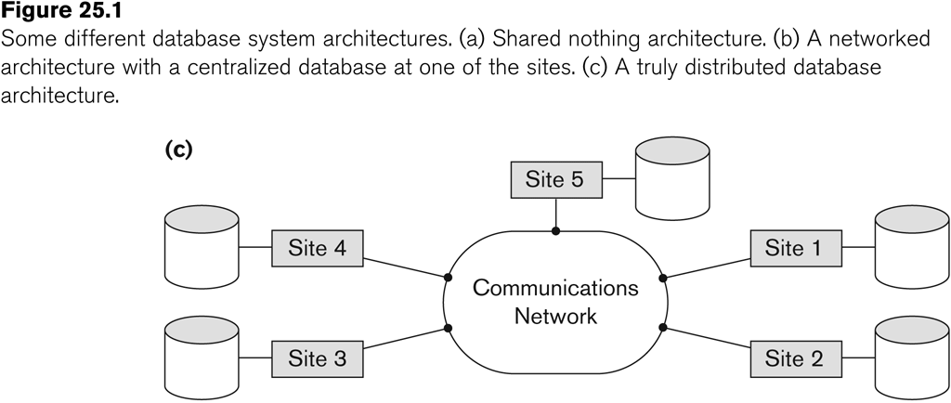
Distributed Database System
Advantages
  Management of distributed data with different levels of transparency:
    This refers to the physical placement of data (files, relations, etc.) which is not known to the user (distribution transparency).
Slide 25- <number>

Slide 65
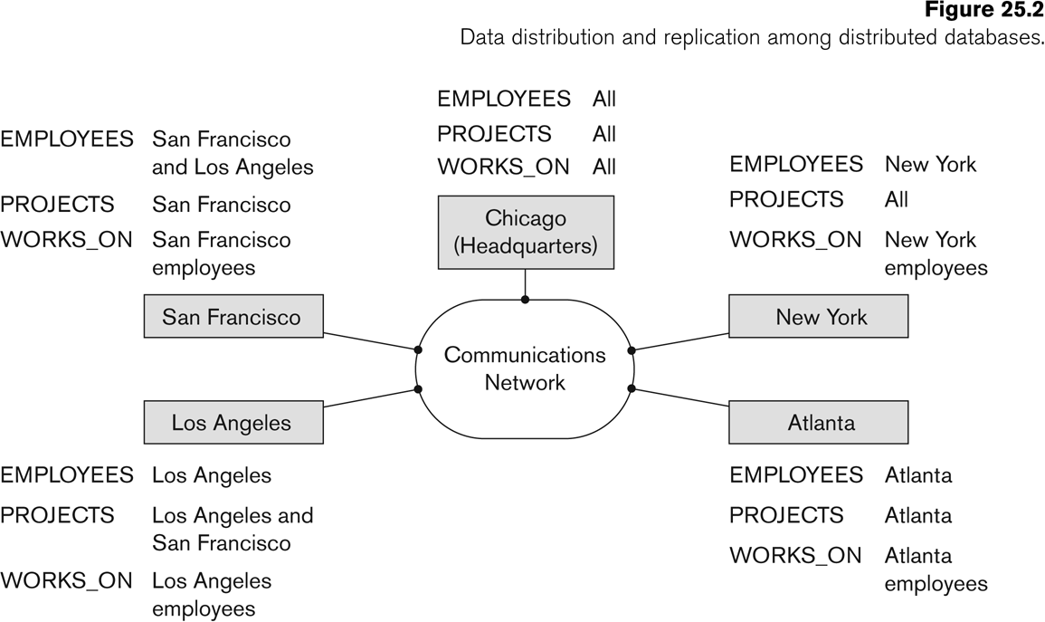
Distributed Database System
Advantages (transparency, contd.)
  The EMPLOYEE, PROJECT, and WORKS_ON tables may be fragmented horizontally and stored with possible replication as shown below.
Slide 25- <number>

Slide 66
Distributed Database System
Advantages (transparency, contd.)
  Distribution and Network transparency:
    Users do not have to worry about operational details of the network.
      There is Location transparency, which refers to freedom of issuing command from any location without affecting its working.
      Then there is Naming transparency, which allows access to any names object (files, relations, etc.) from any location.
Slide 25- <number>

Slide 67
Distributed Database System
Advantages (transparency, contd.)
  Replication transparency:
    It allows to store copies of a data at multiple sites as shown in the above diagram.
    This is done to minimize access time to the required data.
  Fragmentation transparency:
    Allows to fragment a relation horizontally (create a subset of tuples of a relation) or vertically (create a subset of columns of a relation).
Slide 25- <number>

Slide 68
Distributed Database System
Other Advantages
  Increased reliability and availability:
    Reliability refers to system live time, that is, system is running efficiently most of the time. Availability is the probability that the system is continuously available (usable or accessible) during a time interval.
    A distributed database system has multiple nodes (computers) and if one fails then others are available to do the job.
Slide 25- <number>

Slide 69
Distributed Database System
Other Advantages (contd.)
  Improved performance:
    A distributed DBMS fragments the database to keep data closer to where it is needed most.
    This reduces data management (access and modification) time significantly.
  Easier expansion (scalability):
    Allows new nodes (computers) to be added anytime without chaining the entire configuration.
Slide 25- <number>

Slide 70
Data Fragmentation, Replication and Allocation
Data Fragmentation
  Split a relation into logically related and correct parts. A relation can be fragmented in two ways:
    Horizontal Fragmentation
    Vertical Fragmentation
Slide 25- <number>

Slide 71
Data Fragmentation, Replication and Allocation
Horizontal fragmentation
  It is a horizontal subset of a relation which contain those of tuples which satisfy selection conditions.
  Consider the Employee relation with selection condition (DNO = 5). All tuples satisfy this condition will create a subset which will be a horizontal fragment of Employee relation.
  A selection condition may be composed of several conditions connected by AND or OR.
  Derived horizontal fragmentation: It is the partitioning of a primary relation to other secondary relations which are related with Foreign keys.
Slide 25- <number>

Slide 72
Data Fragmentation, Replication and Allocation
Vertical fragmentation
  It is a subset of a relation which is created by a subset of columns. Thus a vertical fragment of a relation will contain values of selected columns. There is no selection condition used in vertical fragmentation.
  Consider the Employee relation. A vertical fragment of can be created by keeping the values of Name, Bdate, Sex, and Address.
  Because there is no condition for creating a vertical fragment, each fragment must include the primary key attribute of the parent relation Employee. In this way all vertical fragments of a relation are connected.
Slide 25- <number>

Slide 73
Data Fragmentation, Replication and Allocation
Representation
  Horizontal fragmentation
    Each horizontal fragment on a relation can be specified by a σ_{Ci} (R) operation in the relational algebra.
    Complete horizontal fragmentation
    A set of horizontal fragments whose conditions C1, C2, …, Cn include all the tuples in R- that is, every tuple in R satisfies (C1 OR C2 OR … OR Cn).
    Disjoint complete horizontal fragmentation: No tuple in R satisfies (Ci AND Cj) where i ≠ j.
    To reconstruct R from horizontal fragments a UNION is applied.
Slide 25- <number>

Slide 74
Data Fragmentation, Replication and Allocation
Representation
  Vertical fragmentation
    A vertical fragment on a relation can be specified by a Π_{Li}(R) operation in the relational algebra.
    Complete vertical fragmentation
    A set of vertical fragments whose projection lists L1, L2, …, Ln include all the attributes in R but share only the primary key of R. In this case the projection lists satisfy the following two conditions:
    L1 ∪ L2 ∪ ... ∪ Ln = ATTRS (R)
    Li ∩ Lj = PK(R) for any i j, where ATTRS (R) is the set of attributes of R and PK(R) is the primary key of R.
    To reconstruct R from complete vertical fragments a OUTER UNION is applied.
Slide 25- <number>

Slide 75
Data Fragmentation, Replication and Allocation
Representation
  Mixed (Hybrid) fragmentation
    A combination of Vertical fragmentation and Horizontal fragmentation.
    This is achieved by SELECT-PROJECT operations which is represented by Π_{Li}(σ_{Ci} (R)).
    If C = True (Select all tuples) and L ≠ ATTRS(R), we get a vertical fragment, and if C ≠ True and L ≠ ATTRS(R), we get a mixed fragment.
    If C = True and L = ATTRS(R), then R can be considered a fragment.
Slide 25- <number>

Slide 76
Data Fragmentation, Replication and Allocation
Fragmentation schema
  A definition of a set of fragments (horizontal or vertical or horizontal and vertical) that includes all attributes and tuples in the database that satisfies the condition that the whole database can be reconstructed from the fragments by applying some sequence of UNION (or OUTER JOIN) and UNION operations.
Allocation schema
  It describes the distribution of fragments to sites of distributed databases. It can be fully or partially replicated or can be partitioned.
Slide 25- <number>

Slide 77
Data Fragmentation, Replication and Allocation
Data Replication
  Database is replicated to all sites.
  In full replication the entire database is replicated and in partial replication some selected part is replicated to some of the sites.
  Data replication is achieved through a replication schema.
Data Distribution (Data Allocation)
  This is relevant only in the case of partial replication or partition.
  The selected portion of the database is distributed to the database sites.
Slide 25- <number>

Slide 78
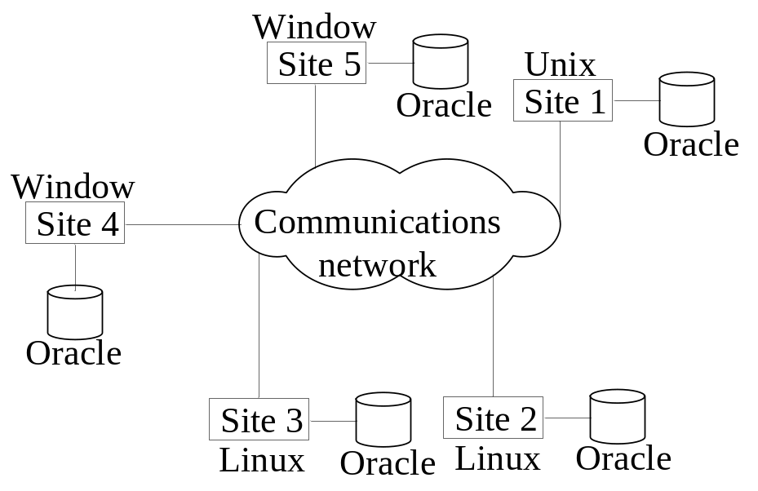
Types of Distributed Database Systems
Homogeneous
  All sites of the database system have identical setup, i.e., same database system software.
  The underlying operating system may be different.
    For example, all sites run Oracle or DB2, or Sybase or some other database system.
  The underlying operating systems can be a mixture of Linux, Window, Unix, etc.
Slide 25- <number>

Slide 79
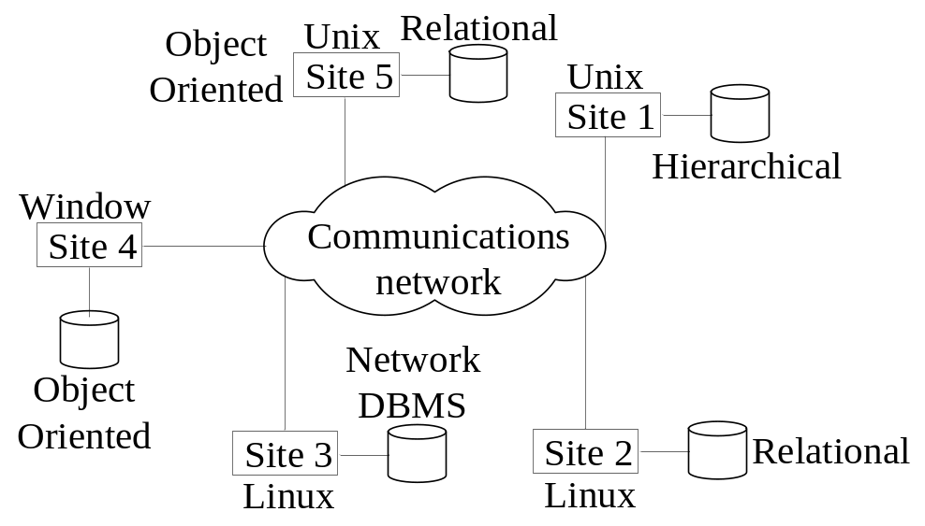
Types of Distributed Database Systems
Heterogeneous
  Federated: Each site may run different database system but the data access is managed through a single conceptual schema.
    This implies that the degree of local autonomy is minimum. Each site must adhere to a centralized access policy. There may be a global schema.
  Multidatabase: There is no one conceptual global schema. For data access a schema is constructed dynamically as needed by the application software.
Slide 25- <number>

Slide 80
Types of Distributed Database Systems
Federated Database Management Systems Issues
  Differences in data models:
    Relational, Objected oriented, hierarchical, network, etc.
  Differences in constraints:
    Each site may have their own data accessing and processing constraints.
  Differences in query language:
    Some site may use SQL, some may use SQL-89, some may use SQL-92, and so on.
Slide 25- <number>

Slide 81

Query Processing in Distributed Databases
Issues
  Cost of transferring data (files and results) over the network.
    This cost is usually high so some optimization is necessary.
    Example relations: Employee at site 1 and Department at Site 2
      Employee at site 1. 10,000 rows. Row size = 100 bytes. Table size = 10⁶ bytes.
      Department at Site 2. 100 rows. Row size = 35 bytes. Table size = 3,500 bytes.
    Q: For each employee, retrieve employee name and department name Where the employee works.
    Q: Π_{Fname,Lname,Dname} (Employee _{Dno = Dnumber} Department)
Fname | Minit | Lname | SSN | Bdate | Address | Sex | Salary | Superssn | Dno
Dname | Dnumber | Mgrssn | Mgrstartdate
Slide 25- <number>

Slide 82
Query Processing in Distributed Databases
Result
  The result of this query will have 10,000 tuples, assuming that every employee is related to a department.
  Suppose each result tuple is 40 bytes long. The query is submitted at site 3 and the result is sent to this site.
  Problem: Employee and Department relations are not present at site 3.
Slide 25- <number>

Slide 83
Query Processing in Distributed Databases
Strategies:
  Transfer Employee and Department to site 3.
    Total transfer bytes = 1,000,000 + 3500 = 1,003,500 bytes.
  Transfer Employee to site 2, execute join at site 2 and send the result to site 3.
    Query result size = 40 * 10,000 = 400,000 bytes. Total transfer size = 400,000 + 1,000,000 = 1,400,000 bytes.
  Transfer Department relation to site 1, execute the join at site 1, and send the result to site 3.
    Total bytes transferred = 400,000 + 3500 = 403,500 bytes.
Optimization criteria: minimizing data transfer.
Slide 25- <number>

Slide 84
Query Processing in Distributed Databases
Strategies:
  Transfer Employee and Department to site 3.
    Total transfer bytes = 1,000,000 + 3500 = 1,003,500 bytes.
  Transfer Employee to site 2, execute join at site 2 and send the result to site 3.
    Query result size = 40 * 10,000 = 400,000 bytes. Total transfer size = 400,000 + 1,000,000 = 1,400,000 bytes.
  Transfer Department relation to site 1, execute the join at site 1, and send the result to site 3.
    Total bytes transferred = 400,000 + 3500 = 403,500 bytes.
Optimization criteria: minimizing data transfer.
  Preferred approach: strategy 3.
Slide 25- <number>

Slide 85
Query Processing in Distributed Databases
Consider the query
  Q’: For each department, retrieve the department name and the name of the department manager
Relational Algebra expression:
  Π_{Fname,Lname,Dname} (Employee _{Mgrssn = SSN} Department)
Slide 25- <number>

Slide 86
Query Processing in Distributed Databases
The result of this query will have 100 tuples, assuming that every department has a manager, the execution strategies are:
  Transfer Employee and Department to the result site and perform the join at site 3.
    Total bytes transferred = 1,000,000 + 3500 = 1,003,500 bytes.
  Transfer Employee to site 2, execute join at site 2 and send the result to site 3. Query result size = 40 * 100 = 4000 bytes.
    Total transfer size = 4000 + 1,000,000 = 1,004,000 bytes.
  Transfer Department relation to site 1, execute join at site 1 and send the result to site 3.
    Total transfer size = 4000 + 3500 = 7500 bytes.
Slide 25- <number>

Slide 87
Query Processing in Distributed Databases
The result of this query will have 100 tuples, assuming that every department has a manager, the execution strategies are:
  Transfer Employee and Department to the result site and perform the join at site 3.
    Total bytes transferred = 1,000,000 + 3500 = 1,003,500 bytes.
  Transfer Employee to site 2, execute join at site 2 and send the result to site 3. Query result size = 40 * 100 = 4000 bytes.
    Total transfer size = 4000 + 1,000,000 = 1,004,000 bytes.
  Transfer Department relation to site 1, execute join at site 1 and send the result to site 3.
    Total transfer size = 4000 + 3500 = 7500 bytes.
Preferred strategy: Choose strategy 3.
Slide 25- <number>

Slide 88
Query Processing in Distributed Databases
Now suppose the result site is 2. Possible strategies :
  Transfer Employee relation to site 2, execute the query and present the result to the user at site 2.
    Total transfer size = 1,000,000 bytes for both queries Q and Q’.
  Transfer Department relation to site 1, execute join at site 1 and send the result back to site 2.
    Total transfer size for Q = 400,000 + 3500 = 403,500 bytes and for Q’ = 4000 + 3500 = 7500 bytes.
Slide 25- <number>

Slide 89
Query Processing in Distributed Databases
Semijoin:
  Objective is to reduce the number of tuples in a relation before transferring it to another site.
Example execution of Q or Q’:
  Project the join attributes of Department at site 2, and transfer them to site 1. For Q, 4 * 100 = 400 bytes are transferred and for Q’, 9 * 100 = 900 bytes are transferred.
  Join the transferred file with the Employee relation at site 1, and transfer the required attributes from the resulting file to site 2. For Q, 34 * 10,000 = 340,000 bytes are transferred and for Q’, 39 * 100 = 3900 bytes are transferred.
  Execute the query by joining the transferred file with Department and present the result to the user at site 2.
Slide 25- <number>

Slide 90
Concurrency Control and Recovery
Distributed Databases encounter a number of concurrency control and recovery problems which are not present in centralized databases. Some of them are listed below.
  Dealing with multiple copies of data items
  Failure of individual sites
  Communication link failure
  Distributed commit
  Distributed deadlock
Slide 25- <number>

Slide 91
Concurrency Control and Recovery
Details
  Dealing with multiple copies of data items:
    The concurrency control must maintain global consistency. Likewise the recovery mechanism must recover all copies and maintain consistency after recovery.
  Failure of individual sites:
    Database availability must not be affected due to the failure of one or two sites and the recovery scheme must recover them before they are available for use.
Slide 25- <number>

Slide 92
Concurrency Control and Recovery
Details (contd.)
  Communication link failure:
    This failure may create network partition which would affect database availability even though all database sites may be running.
  Distributed commit:
    A transaction may be fragmented and they may be executed by a number of sites. This require a two or three-phase commit approach for transaction commit.
  Distributed deadlock:
    Since transactions are processed at multiple sites, two or more sites may get involved in deadlock. This must be resolved in a distributed manner.
Slide 25- <number>

Slide 93
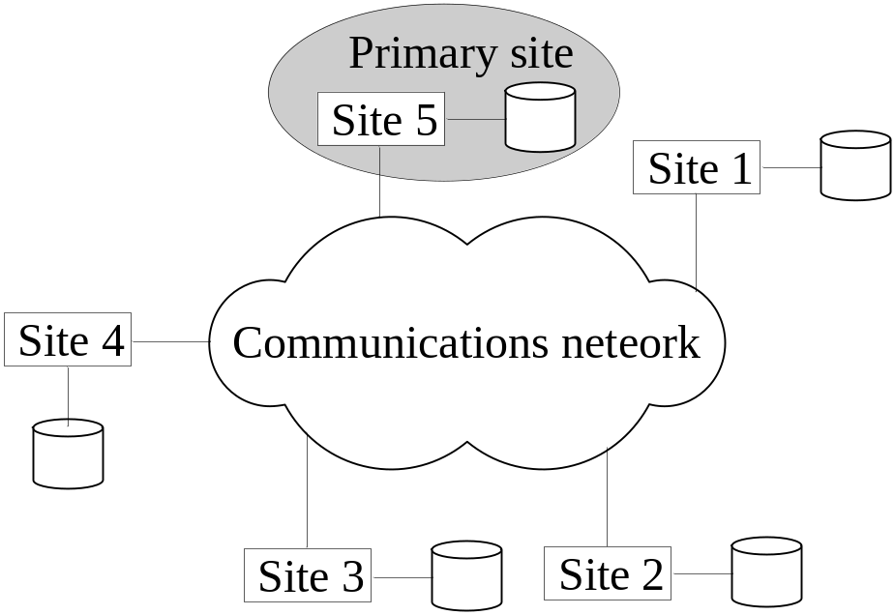
Concurrency Control and Recovery
Distributed Concurrency control based on a distributed copy of a data item
  Primary site technique: A single site is designated as a primary site which serves as a coordinator for transaction management.
Slide 25- <number>

Slide 94
Concurrency Control and Recovery
Transaction management:
  Concurrency control and commit are managed by this site.
  In two phase locking, this site manages locking and releasing data items. If all transactions follow two-phase policy at all sites, then serializability is guaranteed.
Slide 25- <number>

Slide 95
Concurrency Control and Recovery
Transaction Management
  Advantages:
    An extension to the centralized two phase locking so implementation and management is simple.
    Data items are locked only at one site but they can be accessed at any site.
  Disadvantages:
    All transaction management activities go to primary site which is likely to overload the site.
    If the primary site fails, the entire system is inaccessible.
  To aid recovery a backup site is designated which behaves as a shadow of primary site. In case of primary site failure, backup site can act as primary site.
Slide 25- <number>

Slide 96
Concurrency Control and Recovery
Primary Copy Technique:
  In this approach, instead of a site, a data item partition is designated as primary copy. To lock a data item just the primary copy of the data item is locked.
Advantages:
  Since primary copies are distributed at various sites, a single site is not overloaded with locking and unlocking requests.
Disadvantages:
  Identification of a primary copy is complex. A distributed directory must be maintained, possibly at all sites.
Slide 25- <number>

Slide 97
Concurrency Control and Recovery
Recovery from a coordinator failure
  In both approaches a coordinator site or copy may become unavailable. This will require the selection of a new coordinator.
Primary site approach with no backup site:
  Aborts and restarts all active transactions at all sites. Elects a new coordinator and initiates transaction processing.
Primary site approach with backup site:
  Suspends all active transactions, designates the backup site as the primary site and identifies a new back up site. Primary site receives all transaction management information to resume processing.
Primary and backup sites fail or no backup site:
  Use election process to select a new coordinator site.
Slide 25- <number>

Slide 98
Concurrency Control and Recovery
Concurrency control based on voting:
  There is no primary copy of coordinator.
  Send lock request to sites that have data item.
  If majority of sites grant lock then the requesting transaction gets the data item.
  Locking information (grant or denied) is sent to all these sites.
  To avoid unacceptably long wait, a time-out period is defined. If the requesting transaction does not get any vote information then the transaction is aborted.
Slide 25- <number>

Slide 99
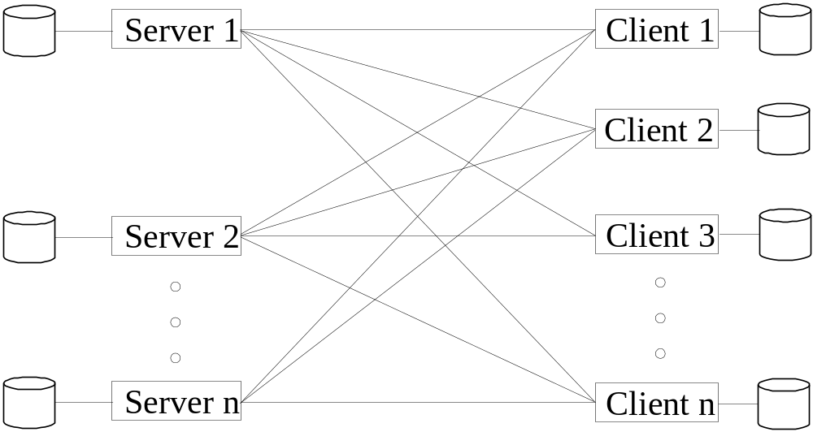
Client-Server Database Architecture
It consists of clients running client software, a set of servers which provide all database functionalities and a reliable communication infrastructure.
Slide 25- <number>

Slide 100
Client-Server Database Architecture
Clients reach server for desired service, but server does reach clients.
The server software is responsible for local data management at a site, much like centralized DBMS software.
The client software is responsible for most of the distribution function.
The communication software manages communication among clients and servers.
Slide 25- <number>

Slide 101
Client-Server Database Architecture
The processing of a SQL queries goes as follows:
  Client parses a user query and decomposes it into a number of independent sub-queries. Each subquery is sent to appropriate site for execution.
  Each server processes its query and sends the result to the client.
  The client combines the results of subqueries and produces the final result.
Slide 25- <number>

